Slide 1
Participatory democracy in the age of angry publics
Nick Mahony, Raymond Williams Foundation

Slide 2
Background - Popular alienation from political class, anger with dysfunctional markets, decline in faith in effectiveness of centralised modes of governance… these sentiments are not new, but are intensifying once again, in our distinct contemporary conditions - Despite many obstacles still existing to participatory democracy, we we are in midst of bout of innovation and are seeing a renewed quest for forms of democratic thinking, practice and engagement that resonate with ‘angry publics’ - How can we understand the politics of these developments? In this contemporary context, how can we more effectively engage?

Slide 3
Citizens’ Economic Council (RSA)

Slide 4
Participatory City

Slide 5
Cooperation Jackson

Slide 6
Brinnington Pantry

Slide 7
A Community Plan for Holloway

Slide 8
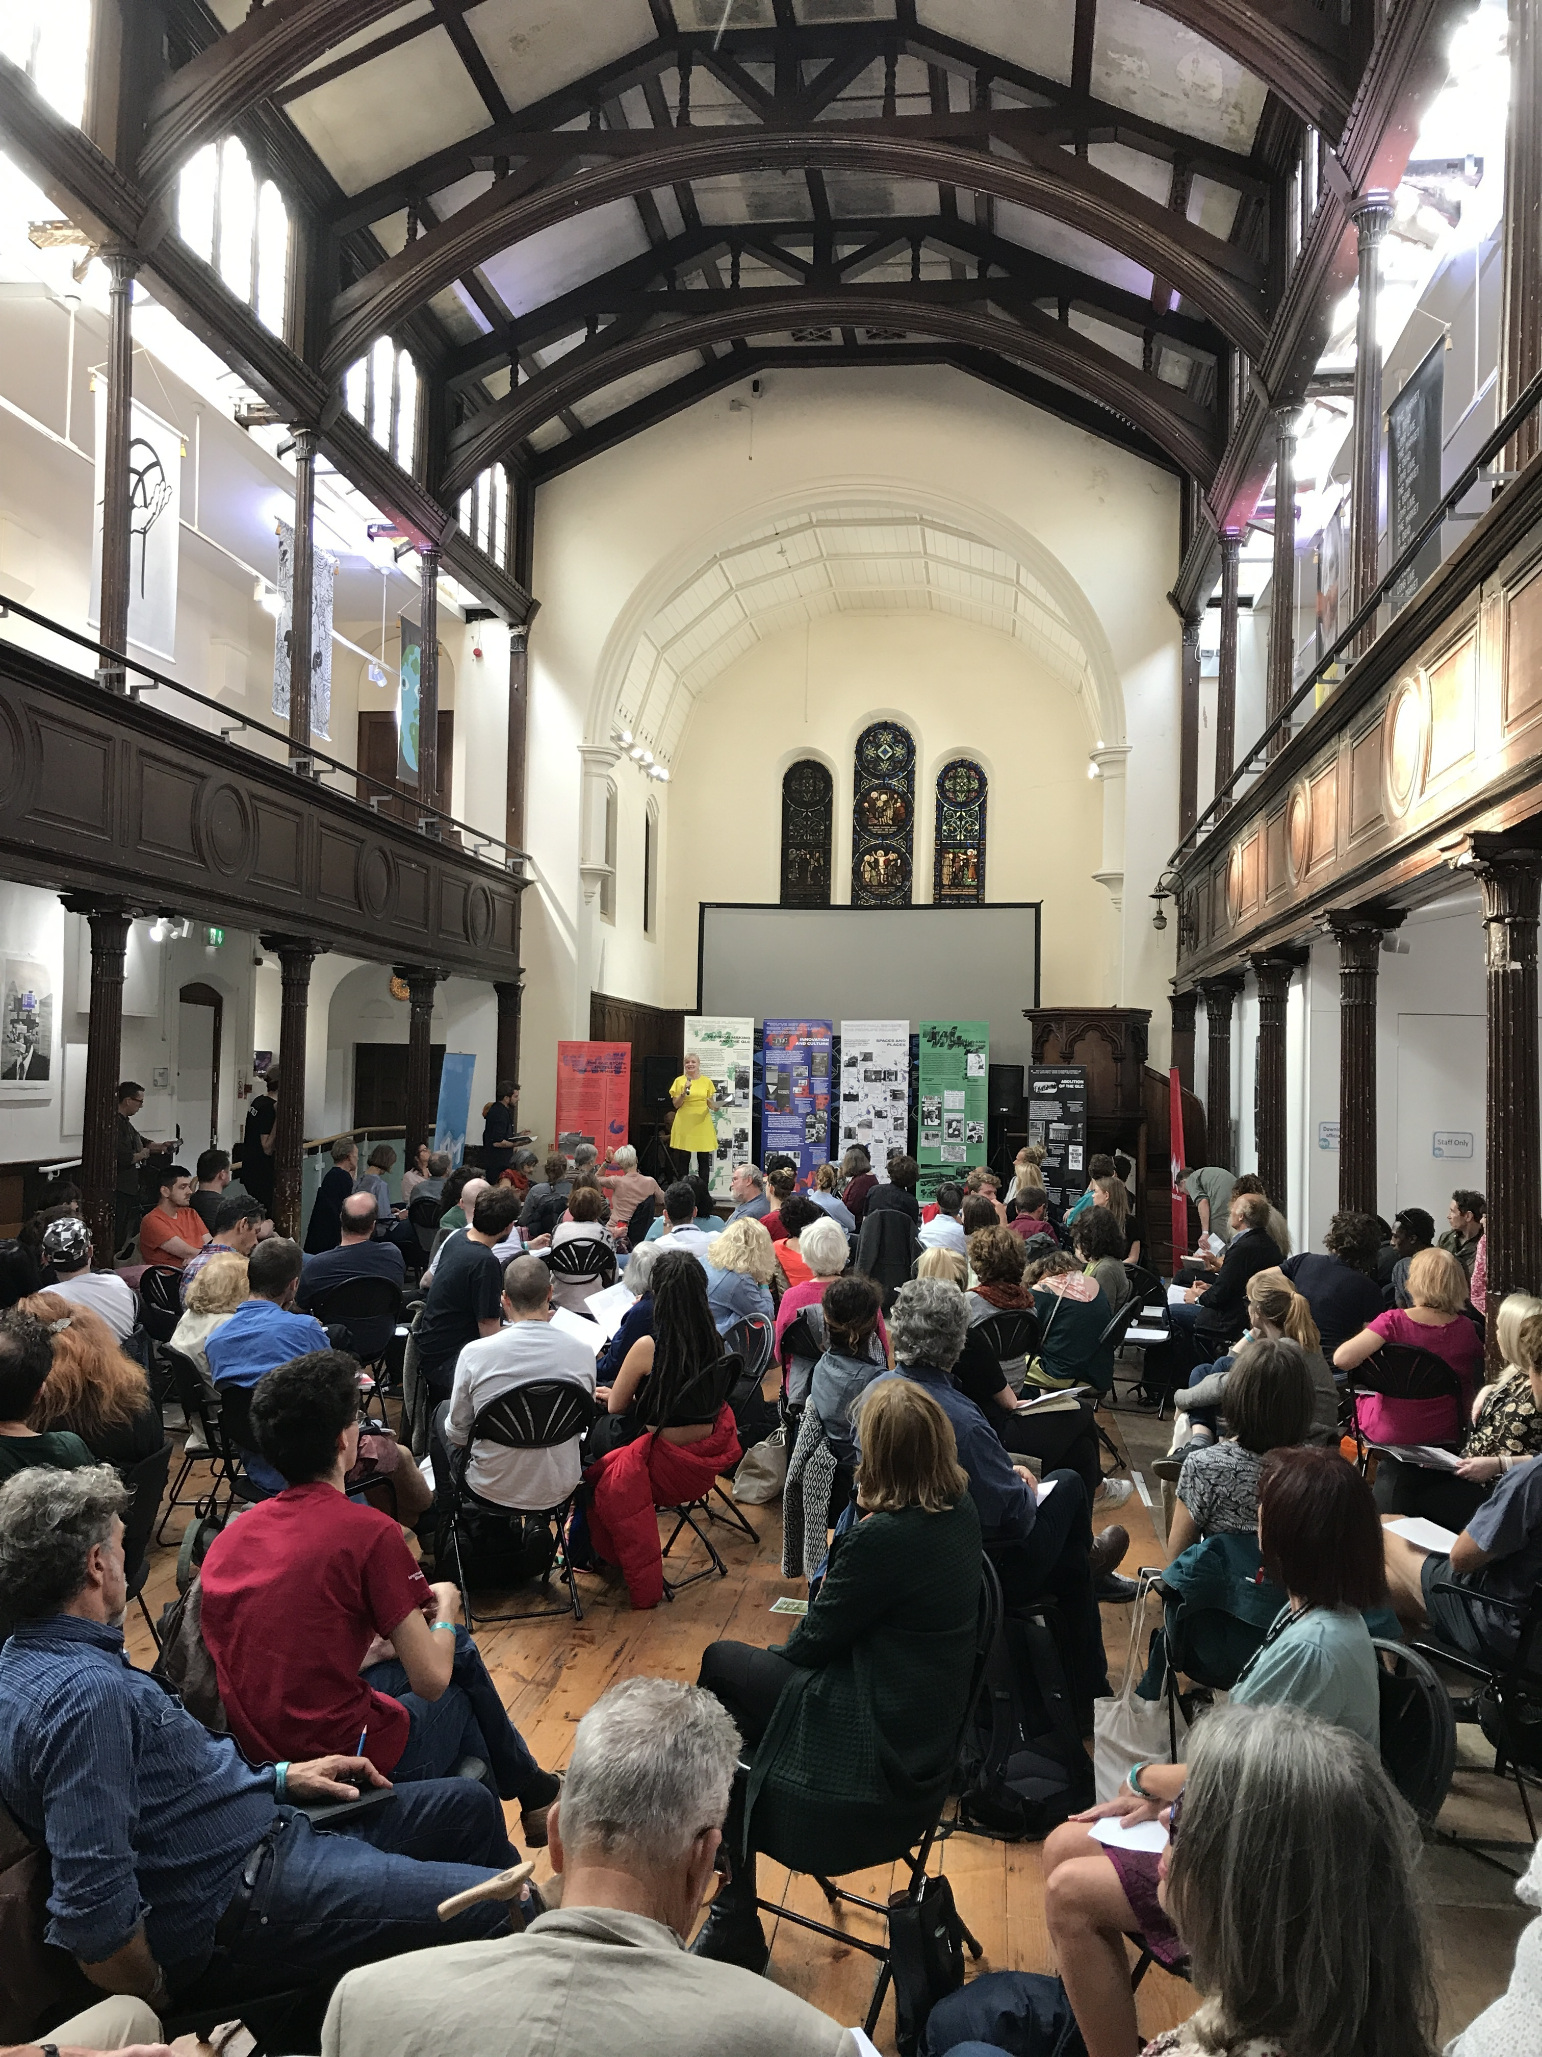
The Movement for a Cultural Democracy project

Slide 9
Community Campaign Unit (Labour Party)

Slide 10
Politics of public mediation: forging approaches to participatory democracy to support diversifying forms of engagement and socio-political action - Examples neither wholly centralised and hierarchical nor wholly privatised and competitive - Though not participatory or democratic in the same ways either - Organinsers’, participants and sponsors have broad range of roles - Diversity also in terms of the kinds of participatory cultures and ethos’ of democratisation being supported - Range of complex and dynamic struggles over who’s in charge (and over what being in charge means)

Slide 11
Politics of public mediation: forging approaches to participatory democracy to support diversifying forms of engagement and socio-political action - So against contemporary background of apparent polarisation, fragmentation, complexity, alienation and crisis… what might a progressive politics of participatory democracy and engagement entail today? - In this landscape, what positions can/should engaged researchers and community activists take: ‘inside’ or ‘outside’ of contemporary struggles over participatory democracy?

Slide 15
Politics of public mediation: forging approaches to participatory democracy to support diversifying forms of engagement and socio-political action - Cognitive justice (Santos) / role of ‘experts’ - Cultural justice (e.g. Williams) - Economic justice and forging alternative ‘solidarity economies’ - Democratic justice, political and creative participation and the renovation of progressive publics

